Slide 1

Web design and development
By Nguyễn Việt Hà

Slide 2
I. Introduction of web technology

Slide 3
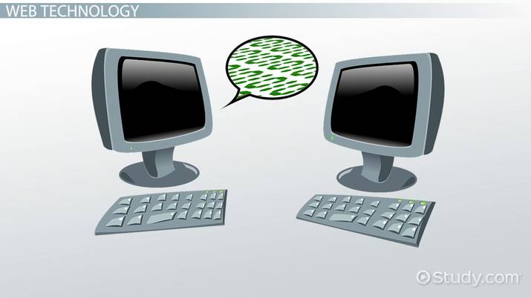
Introduction of web technology
Definition of web technology:
Web technology refers to the mechanisms by which computers interact with one another using markup languages and multimedia bundles.
Web technology has evolved dramatically over the last few decades, from a few marked-up web sites to the potential to perform very complex work on a network without interruption.

Slide 4
Introduction of web technology
Advantages of web technology:
The most significant advantage of internet technology is that they make communication in the computer world more convenient and faster.
Web technology can make a business more efficient and reduces costs, thus increasing its potential.
Disadvantages of web technology:
The internet technologies can be very confusing.
The presence of a device creates the possibility of an attack on the computer program.
Malware may corrupt the devices, causing substantial data to be corrupted or stolen.

Slide 5
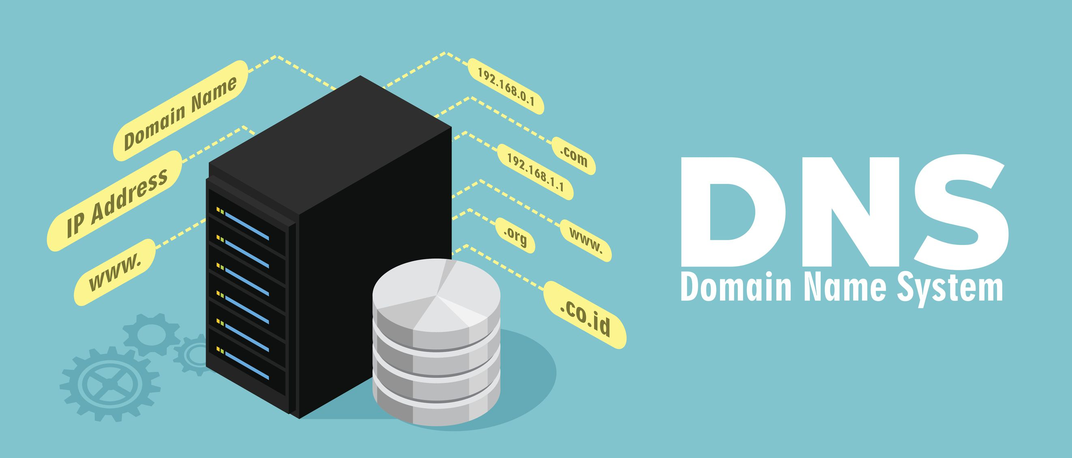
Domain name system (DNS)
Definition of DNS:
The Domain Name System (DNS) also known as the Internet's phonebook.
The domain name system (DNS) is a system that links URLs to the IP addresses. People can look for websites and send emails using common names thanks to DNS, which allows them to type words rather than a string of numbers into a window.

Slide 6
Domain name system (DNS)
4 DNS server involved in loading a website:
DNS recursor: The DNS recursor is a server that collects queries from client machines via web browsers and other applications.
Root nameserver: The root server is the first step in converting human-readable host names to IP addresses. It's mostly used as a pointer to other, more precise sites.
TLD nameserver: The top level domain server (TLD) can be compared to a particular shelf in a library. The last part of a hostname is hosted by this nameserver, which is the next step in the search for a particular IP address.
Authoritative nameserver: In a nameserver query, the authoritative nameserver is the last stop. If the authoritative name server has access to the requested record, it will return to the DNS Recursor that made the initial request the IP address for the requested hostname.

Slide 7

Domain name system (DNS)
How DNS Works:
DNS resolution is the method of translating a hostname (such as www.example.com) into a computer-friendly IP address (such as 192.168.1.1).
When a user requests a webpage, a conversion must take place between the user's feedback (example.com) and the machine-friendly address needed to find the example.com webpage.

Slide 8
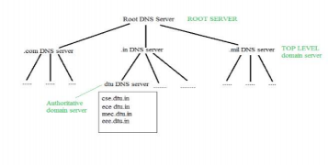
Domain name system (DNS)
How DNS being organized:
DNS servers are arranged in a hierarchical hierarchy and communicate with one another using private network protocols. Root DNS servers, also known as master DNS servers, are responsible for storing Internet domain names and their IP addresses in the whole database.
A DNS server is any computer that is registered with the DNS system and runs special DNS applications to help resolve domain names to their relevant hosts. Each DNS server has a public IP address and maintains a database of network names and addresses for other Internet hosts.

Slide 9
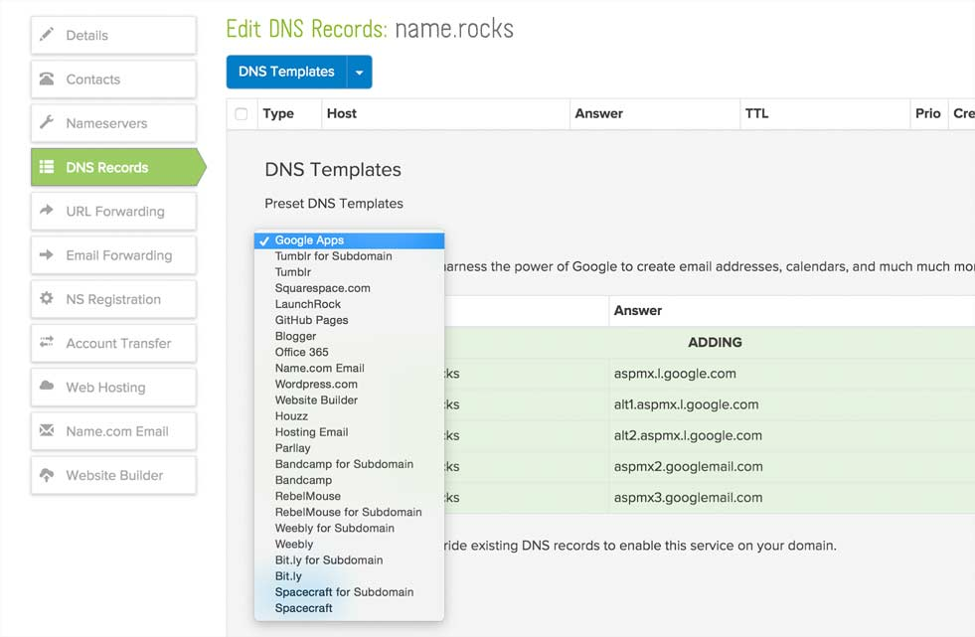
Domain name system (DNS)
How DNS being managed:
DNS management software controls the DNS
Purposes:
When editing complicated and repetitive DNS files, there is less chance of human error.
Reduce the time it takes to edit massive amounts of DNS files.
Until uploading DNS data to DNS servers, verify and automate the delivery of DNS data.

Slide 10
II. Explaination of web elements

Slide 11
Explanation of Web elements
Communication protocol:
A communication protocol is a set of rules that requires two or more individuals in a communications system to send data using some physical quantity variation.
Communication protocols are written explanations of the formats and rules of wireless messages.
Authentication, error detection and correction, and signaling are also covered by communications protocols.
Hardware and software are used to execute communication protocols.

Slide 12
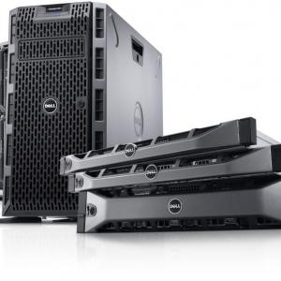
Explanation of Web elements
Server hardware: (Wilbur, 2021)
Server hardware is a kind of device that is programmed to wait for requests from users or other machines before acting on them.
Their primary objective is to be there with you, share info, and complete assignments to keep the process running smoothly and your productivity up.

Slide 13
Explanation of Web elements
Three types of server hardware: (Dealna, 2021)
Tower servers: A tower server is designed to be used as a server and is installed in an upright cabinet. Tower servers are useful because they allow for better cooling due to the lower total part density. The fact that a set of tower servers is bulkier and slower than a blade server or a set of rack servers is one of the drawbacks.
Rack servers: Racks are specifically built to fit into tight spaces and hold several servers. The rack node configuration, in comparison to the tower server, simplifies network cabling.
Blade servers: While blade servers have a similar nature to rack servers, they are thinner and more costly. A blade server is a server chassis that houses server blades, which are small, modular EC boards. Each blade is a server that is usually dedicated to a single program.

Slide 14

Explanation of Web elements
Server software: (What is Server Software? - Definition from Techopedia, 2021)
Definition: Server software is software that is meant to be run, managed, and used on a computer server. It allows and simplifies the use of underlying server processing power for a variety of high-end computing facilities and functions.

Slide 15
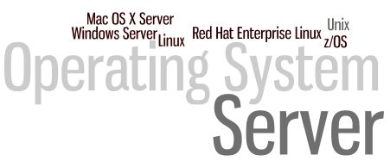
Explanation of Web elements
Server operating system: A server operating system, also known as a server OS, is a computer operating system designed to run on servers, which are specialized machines that operate in a client/server architecture to serve demands from client computers on the network (Stroud, 2021).

Slide 16
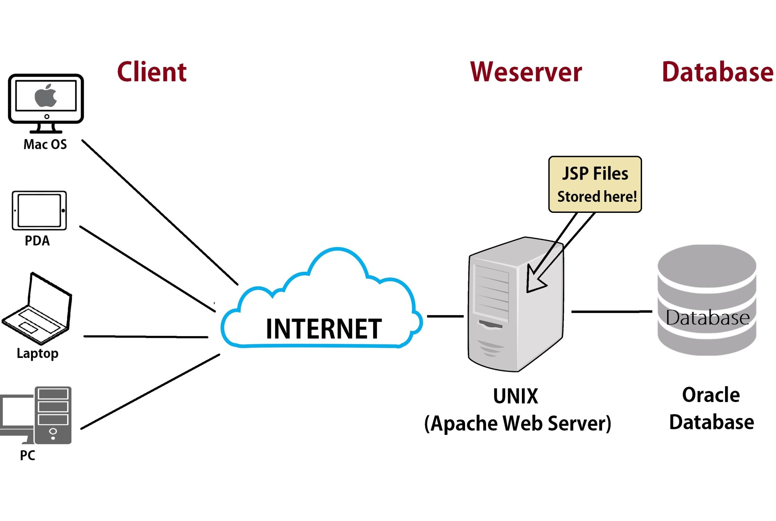
Explanation of Web elements
Web server: A web server is a program that manages the hosting of websites. It's a computer software that requisitions web pages and distributes them as needed. The web server's primary goal is to store, process, and distribute web pages to customers. The Hypertext Transfer Protocol is used for this intercommunication (HTTP) (Barua, 2021).

Slide 17

Explanation of Web elements
Web server:
Apache: The Apache HTTP Server Project is a project aimed at creating and maintaining an open-source HTTP server for mainstream operating systems such as UNIX and Windows. The aim of this project is to create a stable, effective, and extensible HTTP server that complies with current HTTP standards (Welcome! - The Apache HTTP Server Project, 2021).

Slide 18

Explanation of Web elements
Web server:
IIS: IIS (Internet Information Services) is a Microsoft general-purpose web server that runs on Windows systems and supports HTML pages and archives. An IIS web server receives requests from remote client computers and responds accordingly. Web servers can exchange and deliver information through local area networks (LANs), such as corporate intranets, and wide area networks (WANs), such as the internet, using this specific feature (Rosencrance and Bigelow, 2021).

Slide 19
Explanation of Web elements
Relationship of 4 elements
 | Communication Protocols | Server Hardware | Web Server Software | Operation Systems
Designing | Computer and networking systems use rules to connect with one another. |  |  | Web design frameworks should be able to work.
Publishing |  | Data and documents can be uploaded to the Internet. | Create and publish websites on the web. | The application can be circulated and distributed.
Accessing | Data can be exchanged over the internet. | Allow data to be shared between web-connected devices. | Data storage and distribution to consumer computers. | The program can be downloaded from the internet and installed.

Slide 20
III. Web technology

Slide 21
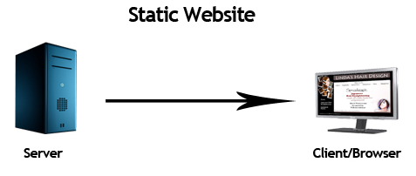
Website Technologies
Static website: A static website is the most simple and straightforward kind of website. To make a static website, you don't need to know much about web engineering or database architecture. HTML is used to code the web sites (Javapoint, 2021).

Slide 22
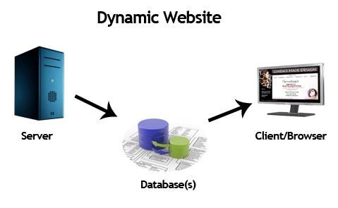
Website Technologies
Dynamic website: A dynamic website is a series of dynamic web pages with dynamic content. It uses a database or a Content Management System to get content (CMS). As a result, when you change or update the database's content, the website's content is either changed or modified (Javapoint, 2021).

Slide 23
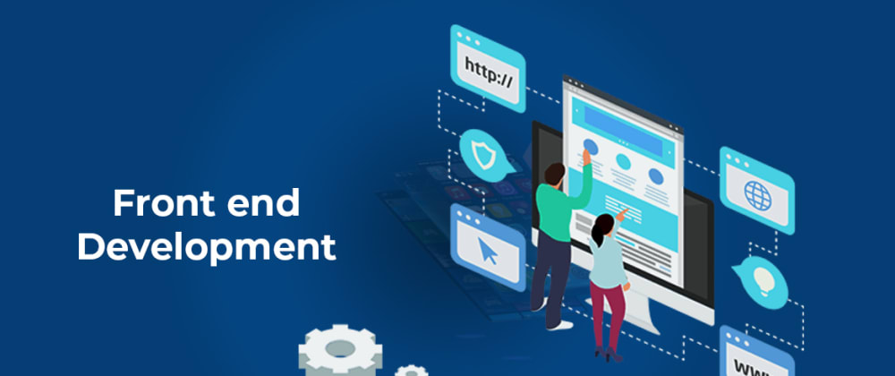
Website Technologies
Front-end Technology: The front end of a website is all you see and communicate with from a browser. Front-end creation is the term used to describe the process of developing this graphic component. Since they are working on the same aspect of the project, you might also argue that programmers who create user interfaces and plan interactions are also front-end developers (Soft, 2021).

Slide 24
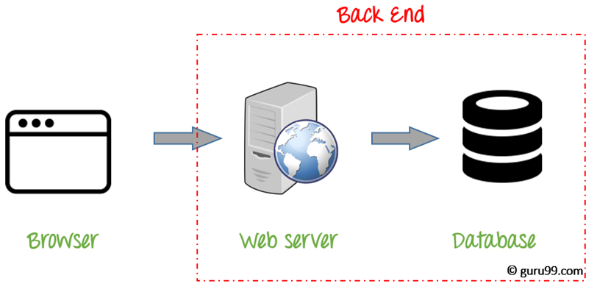
Website Technologies
Back-end Technology: The back end, on the other hand, is all that occurs behind the scenes. It houses the servers that host the web pages as well as the logic that controls the website's operations and processes (Soft, 2021).

Slide 25
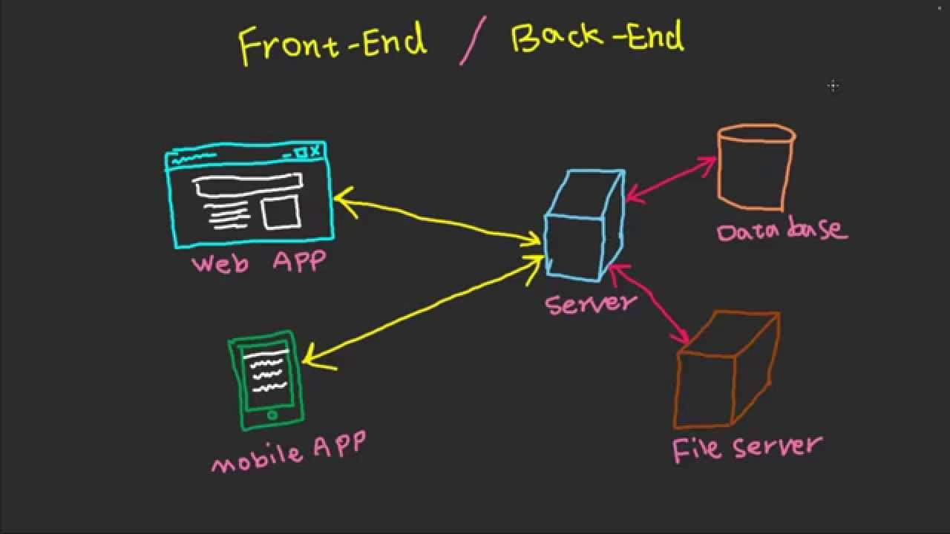
Website Technologies
Essentials of Front-end and Back-end:
The frontend is also known as the "client-side" of an application, as opposed to the backend, which is the "server-side." Languages like Java, Ruby, Python, PHP,.Net, and others are important for backend web creation. HTML, CSS, and JavaScript are the most popular frontend languages (Khillar, 2021).
Role of Front-end and Back-end:
Both are critical components of web creation, and despite their variations, they are like two sides of the same coin. The graphic features of a website that a person can see and feel are referred to as frontend. Backend site creation, on the other hand, is responsible for all that occurs in the past. It's sort like a frontend user experience enabler (Khillar, 2021).

Slide 26
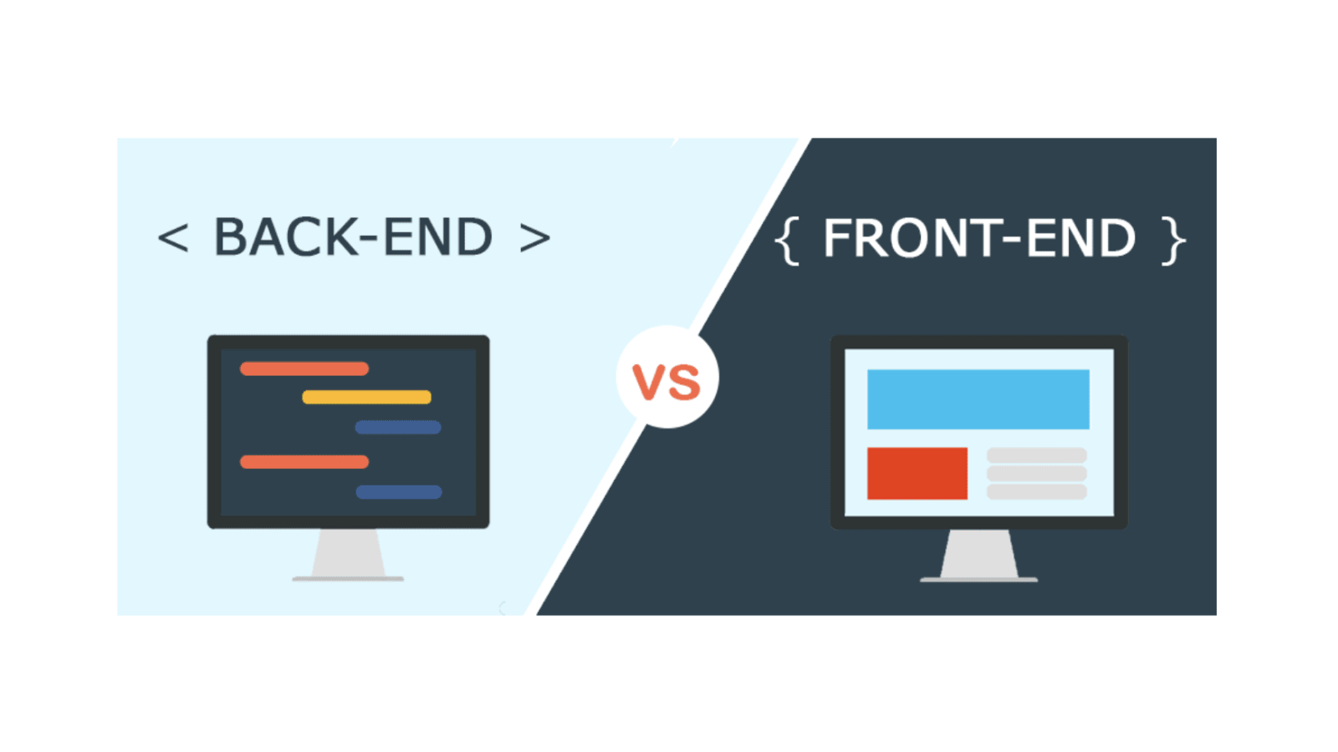
Website Technologies
Summary of Front-end and Back-end:
Although both the frontend and the backend are essential to the operation of a website, they do have certain technical variations. The client-side is referred to as the frontend, while the server-side is referred to as the backend. Both are important in web creation, but their tasks, duties, and working conditions are somewhat different. The frontend is what people see, while the backend is when everything happens (Khillar, 2021).

Slide 27
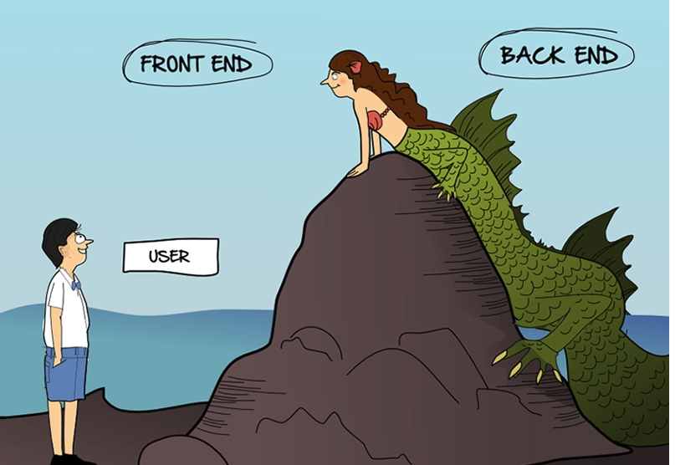
Website Technologies
The relationship between front end – back end, presentation layer – application layer:
There are some distinctions between front-end and back-end web development. Although the front-end focuses on making your website look as good as possible, the back-end is responsible for all of the tricky and messy stuff that makes the website work. For this function, the front-end of a web application is sometimes referred to as client-side, whereas the back-end is usually referred to as server-side.
Despite their variations, Front-End and Back-End Web Development are two sides of the same coin!!! Both are equally relevant, and a website can only function properly when they operate together.

Slide 28
Website Technologies
The relationship between front end – back end, presentation layer – application layer:
User management providers are what the application layer is all about. Thus, it is the protocols that an email client needs in order to deliver email, not the email client itself.
The display layer (which should have been called the representation layer) is concerned with the presentation of results. There are some components of this. One is because some computers/processors use the most important bit of a word as the MSB, while others use the rightmost. The conversion is handled by the presentation layer, which allows these two devices to connect.
Another point to consider is that certain applications can transmit structured data (e.g., a database, a linked list, etc.). Due to the fact that data networks can only transmit "static" (i.e., unstructured) data, the display layer must encrypt the structure in order to reconstruct it at the destination. The OSI specification ASN.1 is responsible for this (Abstract Syntax Notation).

Slide 29
IV. Online creation tools and custom built

Slide 30

Online creation tools and custom built
Examples of online creation tool:
Wix:
Wix.com Ltd. is a cloud-based software development firm based in Israel. It uses online drag-and-drop software to allow users to build HTML5 websites and mobile websites (Thompson, 2021).

Slide 31

Online creation tools and custom built
Examples of online creation tool:
Google Slides:
Google Slides is a valuable extension to the Google suite if you already use other Google services. Using pre-made models, you can easily construct visually pleasing presentations. Slides may also be used to work with PowerPoint presentations that have been imported or to export your own creations to PowerPoint. Best of all, you'll never forget your job because it is saved automatically (Thompson, 2021).

Slide 32

Online creation tools and custom built
Examples of online creation tool:
Adobe Spark:
Adobe Spark is a content development tool that allows you to quickly blend text, pictures, and video for better online storytelling (Thompson, 2021).

Slide 33
Online creation tools and custom built
 | Online creation tools | Custom built website
Design flexibility | Minimal customization Rapid progressing production | Adapt to the needs of the customer Production process is adaptable.
Performance | Not optimized for search engines. The design of a responsive website is challenging. | Build a responsive website with ease. SEO is simple to implement.
Functionality | Tool support is minimal. Well-maintained tools are available. | More difficult to use No limit in creating design
UX | It's similar to most websites. Boring and unimpressive. | The design is special Interesting and a strong first impression
UI | It is dependent on the resources. | Based on the website, it's one-of-a-kind.

Slide 34
Reference:
https://study.com/academy/lesson/what-is-web-technology-definition-trends.html
http://www.webinfosearch.com/web-technology/web-technology-its-definition-and-importance.htm
https://www.cloudflare.com/learning/dns/what-is-dns/
https://www.advantage.tech/service/server-hardware
https://dealna.com/en/Article/Post/1391/Three-Types-of-Server-Hardware
https://www.techopedia.com/definition/23735/server-software
https://www.webopedia.com/definitions/server-operating-system/
https://economictimes.indiatimes.com/definition/web-server
http://httpd.apache.org/
https://searchwindowsserver.techtarget.com/definition/IIS
https://www.javatpoint.com/website-static-vs-dynamic
https://www.altexsoft.com/blog/front-end-development-technologies-concepts/
http://www.differencebetween.net/technology/difference-between-frontend-and-backend/
https://manage.wix.com/account/sites
https://optinmonster.com/best-visual-content-creation-tools/
https://www.geeksforgeeks.org/what-is-the-difference-between-front-end-and-back-end-web-development/

